Slide 1
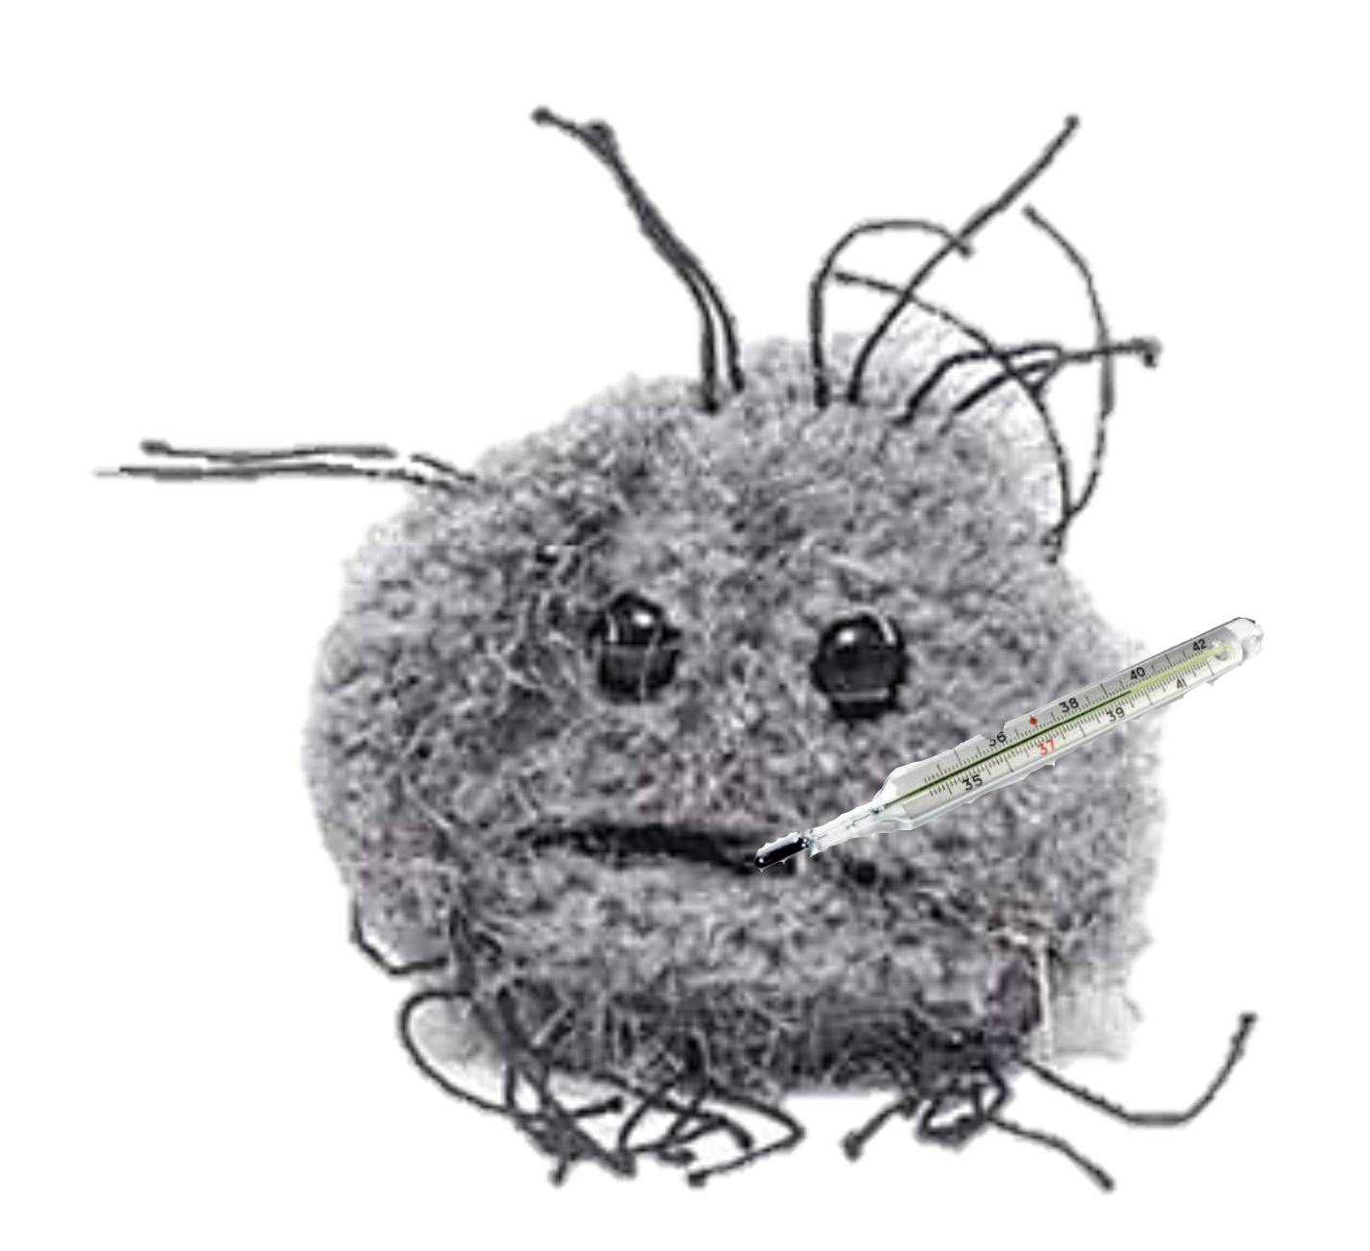
Cancer UNIT 4
How does cancer make us sick?

Slide 2
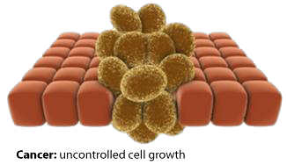
Cancer
Lesson 4.1
What is cancer?

Slide 3
Do Now
What is a tumor? Are all tumors cancers?
Define the terms benign tumor and malignant tumor
How does a benign tumor become malignant?
A tumor only becomes cancer when it is malignant

Slide 4
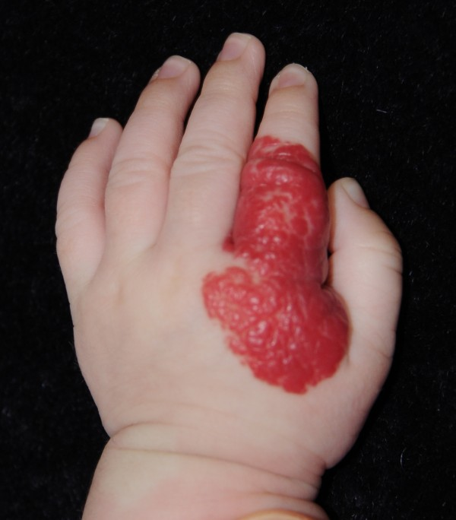
Which of these could be cancerous?

Slide 5
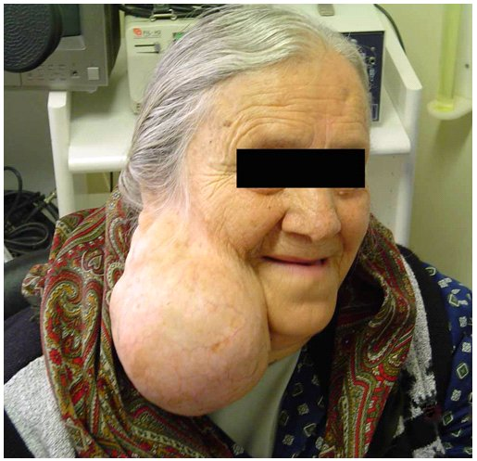
Is this tumor cancerous?
This is a tumor of the parotid gland but it is not cancerous
Size does not play a role in whether a tumor is cancerous

Slide 6
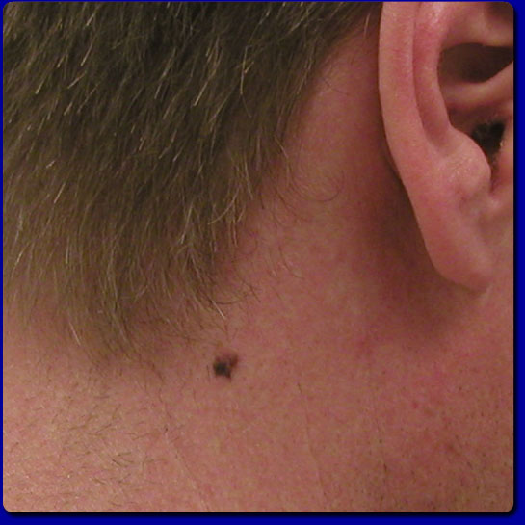
Is this tumor cancerous?
This tumor of the skin is cancerous
Size does not play a role in whether a tumor is cancerous

Slide 7
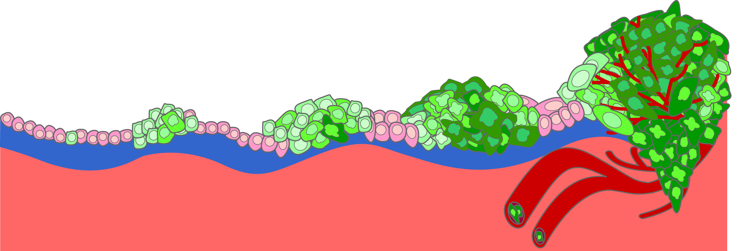
Three types of tumors
Metastatic tumors
Can travel to distant sites
via bloodstream
Malignant tumors
can invade the stroma
Benign tumors
Grow, but cannot migrate
Stroma
Time
‘Cancer’ refers to malignant and metastatic tumors

Slide 8
Metastasis
The ability of tumor cells to migrate from the primary site
through the blood stream or lymph vessels
and then develop secondary tumors at distant sites.

Slide 9
This tumor is benign
This is a tumor of the parotid gland – it is not cancerous
It is localized in place and easy to remove surgically

Slide 10
This tumor is malignant
This is a malignant tumor of the skin – a melanoma
It has begun to invade the stroma

Slide 11
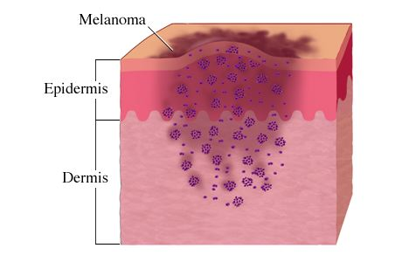
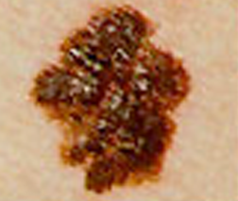
Invasiveness defines how severe a cancer is
‘Cancer’ refers to malignant and metastatic tumors

Slide 12
Characterizing skin tumors
A – Assymetrical
B – Borders are irregular
C – Color is inconsistent
D – Diameter is more than 6 millimeters
E – Tumor is evolving in size, shape, color, elevation or another trait
Cancers are characterized by GRADE and STAGE

Slide 13
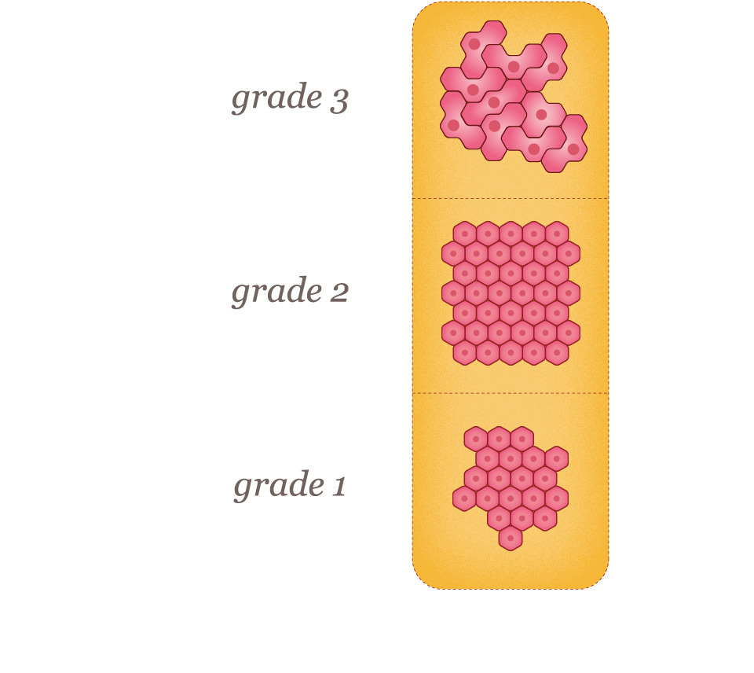
Grade describes how different cancer cells are from normal cells
High grade
Low grade
Grade defines how invasive a tumor is likely to be.

Slide 14
High grade = De-differentiation
Stem cell
Cancer cell
‘Immortal’
Not specialized
‘Immortal’
Not specialized
High replication
Invasive
Progenitors
High replication
Not immortal
Some specialization
Terminal Differentiation
De-differentiation
No replication
Specialized functions

Slide 15
Cancer Grade – How different cells are from normal
Basement
membrane
Grade 1
Hyperproliferates:
Look normal
Grade 2
Hyperproliferates:
Look abnormal
Grade 3
Hyperproliferates:
De-differentiated
Grade 0
Normal
As tumor cells de-differentiate they are more
likely to become invasive

Slide 16
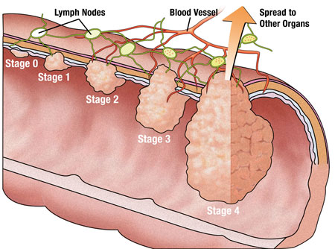
Cancer stage - how much the tumor has spread
Stage describes how far the cells have migrated

Slide 17
Cancer Stage – How much has the tumor spread?
Stage 0 (benign)
Stage I (malignant)
Stage II (malignant)
Stage III (metastatic)
Stage IV (metastatic)
Remains within basement membrane
Small tumor, local invasion
Larger tumor, local invasion
Large tumor, lymph node invasion
Tumor migrates into other organs

Slide 18
Activity Characterizing skin tumors
A - Assymmetrial
B – Borders are irregular
C – Color is inconsistent
D – Diameter is more than 6mm
E – Tumor is evolving in size, shape, color, elevation or other trait.

Slide 19
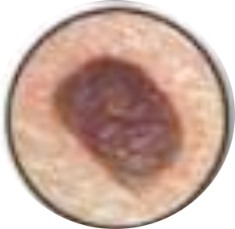
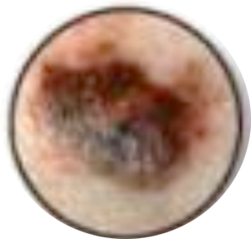
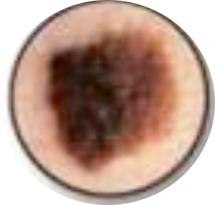
Activity Characterizing skin tumors
Take a look at these pictures of skin tumors. Categorize each as benign or malignant
A
B
C
D
E
F
G
H
I
J

Slide 20
Activity – Characterizing skin tumors
E
B
G
C
I
Benign
Malignant
A
J
D
F
H

Slide 21
Activity – Characterizing skin tumors
E
B
G
C
I
Benign
Assymmetry
Border
Color
Diameter
Evolving
Malignant
A
J
D
F
H

Slide 22
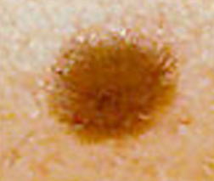
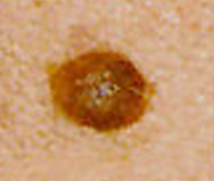
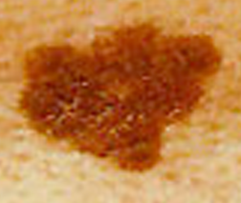
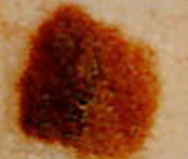
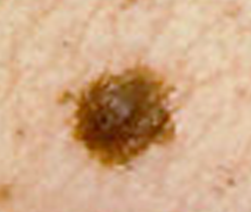
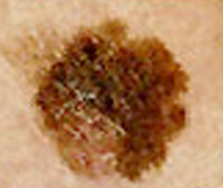
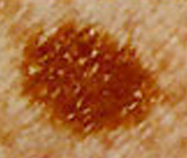
What about these?
M
M
1
2
3
4
5
6
7
8
M
M

Slide 23
Tumor grades
Grade 0
A
B
C
Notes:
Do we need arrows here?

Slide 24
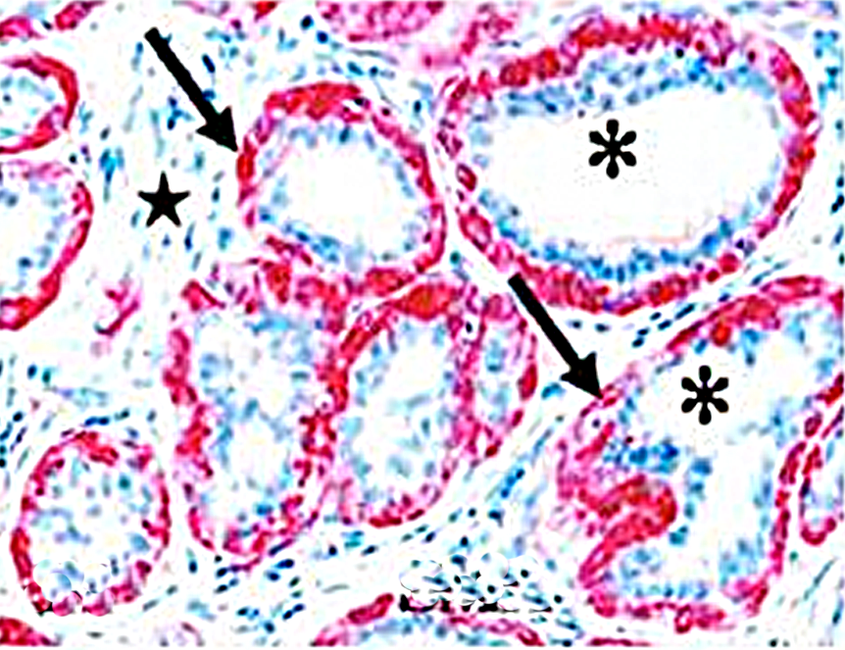
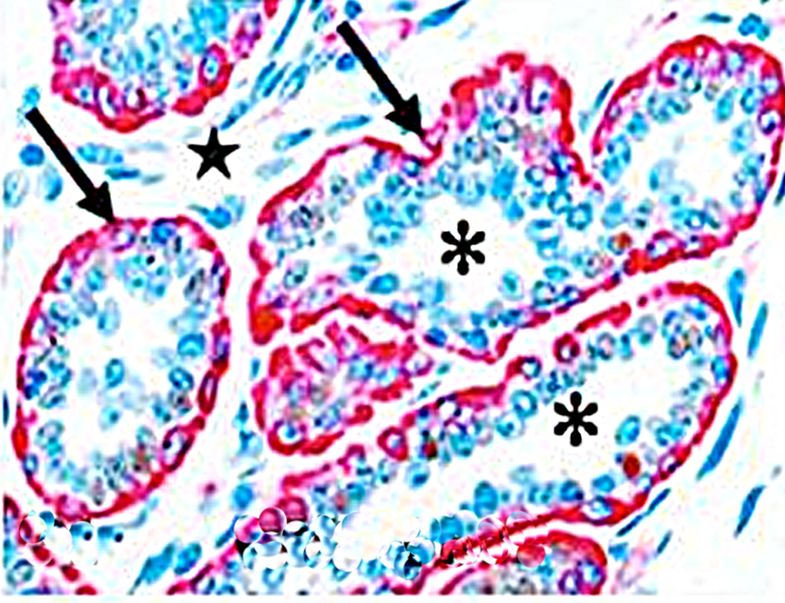
Wrap up: High grade or High stage?
Breast tissue
Prostate tissue
The extent of spread is threatening to health, but the more similar cells are to the original, the easier they are to treat.
Notes:
What is the point of these arrows?

Slide 25
Homework
Watch Ted talk that describes how diet can starve cancer of its blood supply

